Slide 1
Name : Partibha
Uid : 18BCS6093
BRANCH: CSE (Artificial Intelligence and Machine Learning)

Slide 2
Project Title: Best Mobile Price

Slide 3
INTRODUCTION
1.1 Problem Definition:
MOBILE BEST PRICE is about calculating best price of a used mobile phone so that we can buy or sell the same at a fair market price. This project will help in getting us the fair market price of a second hand mobile phone which is very necessary as there are chances that someone may ask for false price. So if you MBP you can demand the real price. This project is developed in java using instant variables, if else loops and user defined method.
1.2 Project Overview:
Mobile Best Price is an algorithmic java based project which gives the estimated market price of any used mobile phone. It asks the user to enter the phone’s company name, model name, age and condition of the mobile phone based on its age. Then it calculates the market price based on all this factors. MBP aware you about the specifications of the mobile phone.

Slide 4
1.2.1 How does it work?
• Program firsts ask the user to select the name of the company of which the user wanted to buy or sell the mobile phone.
• After selecting the company name the program shows you the list of all the main models that belong to that company and ask user to select which model he or she wants.
• After selecting the model name it asks the user to select the age of the mobile phone. It uses the concept that less the mobile phone age is more the price of that mobile phone. If the age of the phone is between 0 to 6 months it tells you the price according to that considering that the condition of the mobile phone would be okay. If the age of the mobile is between 6 to 12 months or above than that then it will first ask the user about the condition of the phone and then it will tell you the price.
• With the price of the mobile phone it also shows up the specifications of the mobile phone.

Slide 6
TABLE(B)

Slide 8
HARDWARE SPECIFICATIONS:
Lenovo Ideapad 330
Intel core i3-8130U(8th Gen)
2.2 Ghz
Hard Disk : 1 TB
RAM : 4 GB
2. SOFTWARE SPECIFICATIONS:
OPERATING SYSTEM: Windows 10 Home Basic
OS TYPE: 64-bit

Slide 12
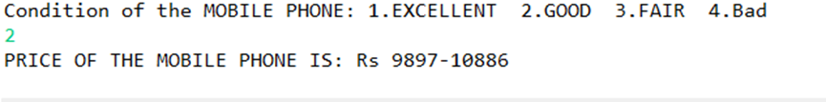
SELECT CONDITION AND FAIR MARKET PRICE:

Slide 13
TESTING PROCESS:
Program firsts ask the user to select the name of the company of which the user wanted to buy or sell the mobile phone.
After selecting the company name the program shows you the list of all the main models that belong to that company and ask user to select which model he or she wants.
After selecting the model name it asks the user to select the age of the mobile phone. It uses the concept that less the mobile phone age is more the price of that mobile phone. If the age of the phone is between 0 to 6 months it tells you the price according to that considering that the condition of the mobile phone would be okay. If the age of the mobile is between 6 to 12 months or above than that then it will first ask the user about the condition of the phone and then it will tell you the price.

Slide 14
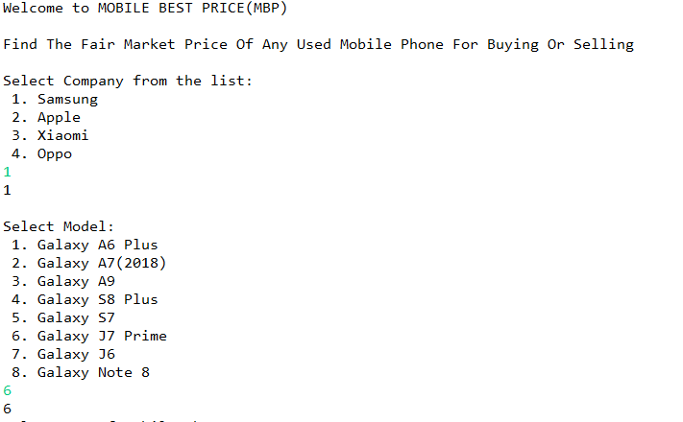
OUTPUTS AND RESULTS

Slide 15
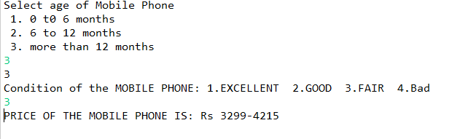

Slide 16
CONCLUSION
This project is really very helpful in knowing the best price of a second hand phone. Indians generally think of buying second hand phones instead of buying a new one. So selling and buying of a used phone becomes fair with this project. This can be developed further more with time to make it more reliable and efficient.
This project uses algorithms and logic which tells you the fair market price of any used phone by knowing its company name, model name, age and condition according to age. If you want to see how to decide condition of the phone you can check the specifications in table(A), table(B) , table(C).
This project tells you the range between you can buy or sell the mobile phone.

Slide 17
REFERENCES
Orange Book Value: this is a app which tells the fair market price of used vehicles.
https://gadgets.ndtv.com (for finding actual market price of each mobile phone)
Olx : an app which allow to buy or sell used things.

Slide 18
THE END

